Slide 1

School of Statistics & School of Data Science and Forecasting
“GDP and Its Determinants: Investigating the Impact of FDI, Inflation, Unemployment, and Exchange Rates
Prepared By - Nishant Deshmukh
Guided By – Dr. Arpita Lakhre

Slide 2
Introduction
In the world of economics, understanding the intricate relationships between various macroeconomic indicators is crucial for policymakers, investors, and researchers alike. This research project, titled "GDP and Its Determinants," endeavors to provide a thorough study of exploring the dynamics between Gross Domestic Product (GDP) and a cluster of other key variables: Foreign Direct Investment (FDI), inflation, unemployment, and exchange rates. These variables collectively influence and reflect the economic health and performance of a nation, making their interplay a subject of significant interest and importance.
This project uses a method called multiple regression to study how these factors work together to impact GDP. By analyzing their relationships, we can understand better how FDI, inflation, unemployment, and exchange rates affect a country's economic growth.

Slide 3
Purpose of Study and Research Question
The primary research question guiding this study is, "What is the impact of FDI, Inflation, Unemployment, and Exchange Rates on GDP?” the following questions are considered:
How does foreign direct investment (FDI) and exchange rate collectively/individually influence a nation's gross domestic product (GDP)?
How does unemployment rate and inflation impact Gross Domestic Product (GDP) in various economic scenarios?
What is the effect of exchange rate fluctuations on a country's Gross Domestic Product (GDP) and how do these factors interact with each other to collectively shape economic growth and stability?

Slide 4
Review of the Related Literature
Gross domestic product (GDP) - Gross domestic product (GDP) is the total monetary or market value of all the finished goods and services produced within a country’s borders in a specific time period.
Foreign direct investment (FDI) - Foreign direct investment (FDI) is an investment made by a company or an individual in one country into business interests located in another country. FDI is an important driver of economic growth.
Inflation - Inflation refers to a sustained and general increase in the prices of goods and services in an economy over time. Inflation occurs when there is too much money chasing too few goods, leading to an imbalance between supply and demand.

Slide 5
Unemployment - Unemployment refers to the state of being without a job but actively seeking Employment. It is a measure of the number of people in the workforce who are willing and able to work but are unable to find employment
Exchange rate - Exchange rate refers to the value of one currency in terms of another currency. It represents the price at which one currency can be exchanged for another currency in the foreign exchange market.

Slide 6
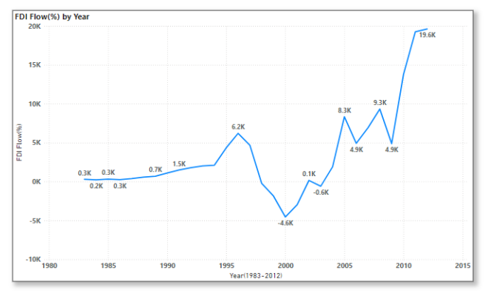
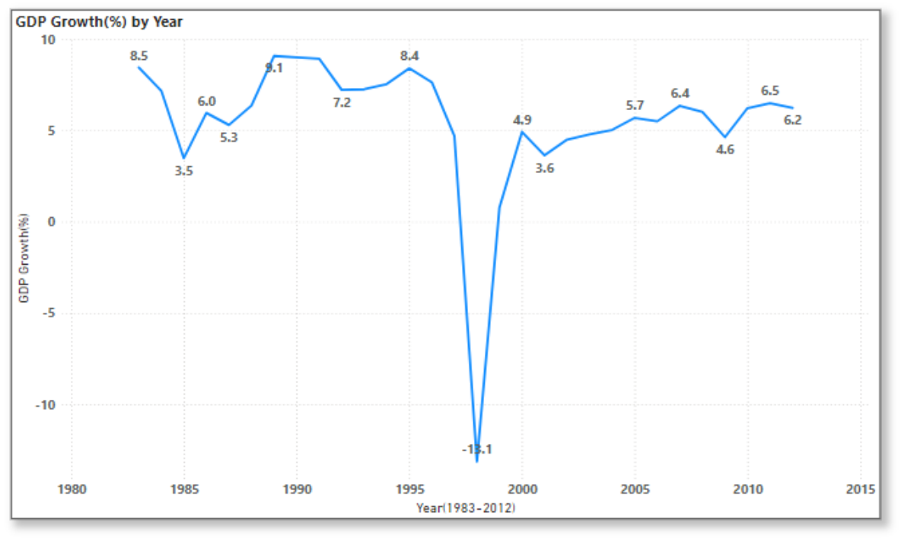
Data Visualizations

Slide 7
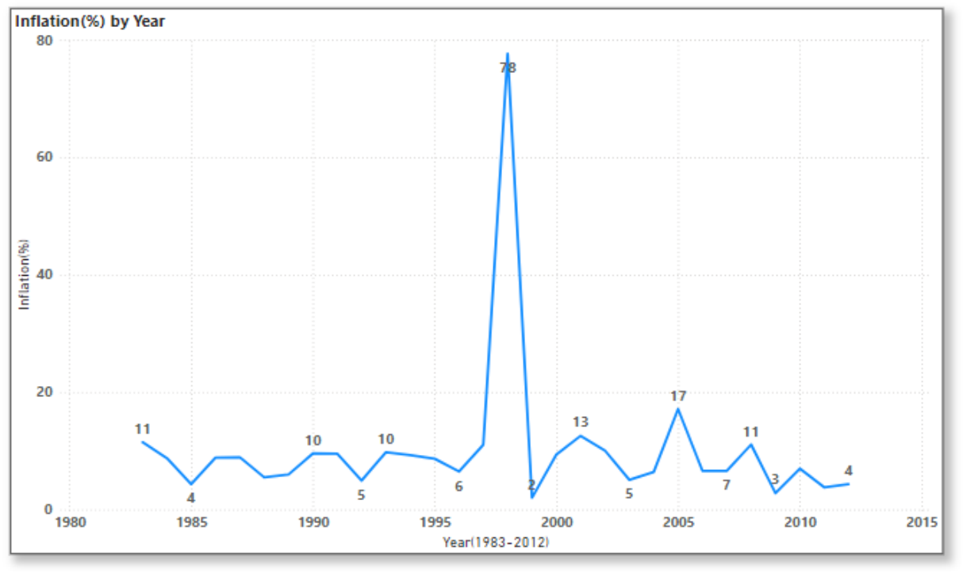
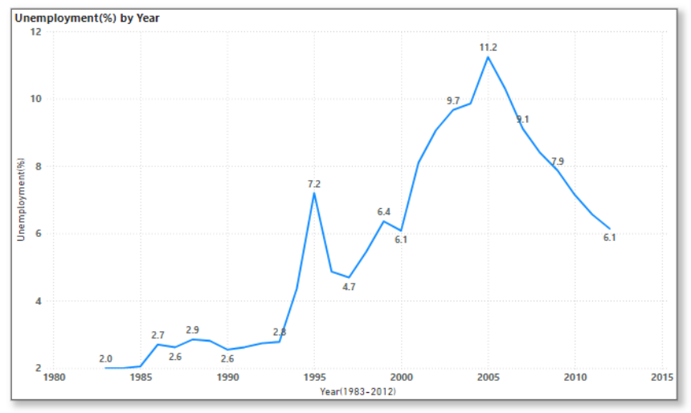
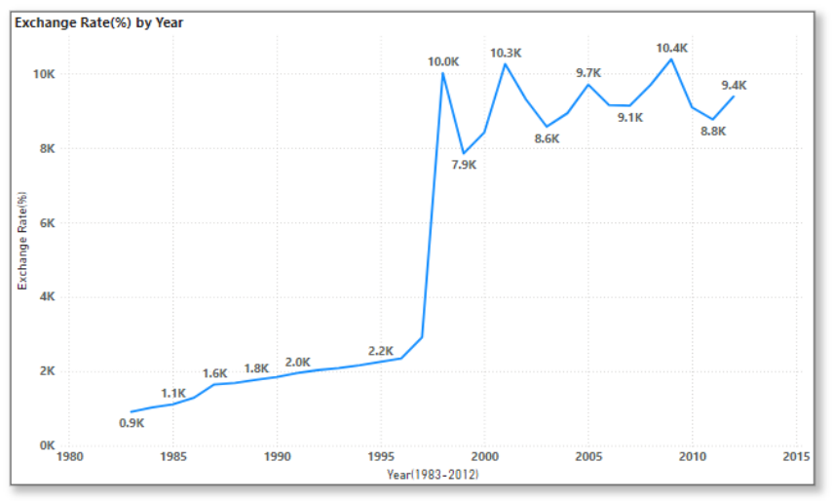

Slide 8
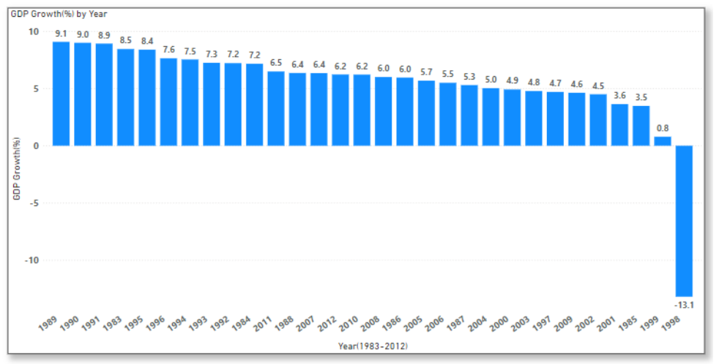
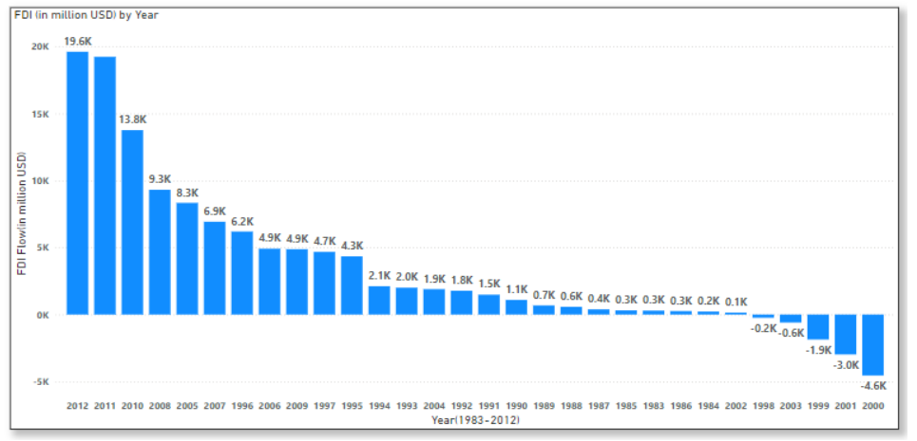
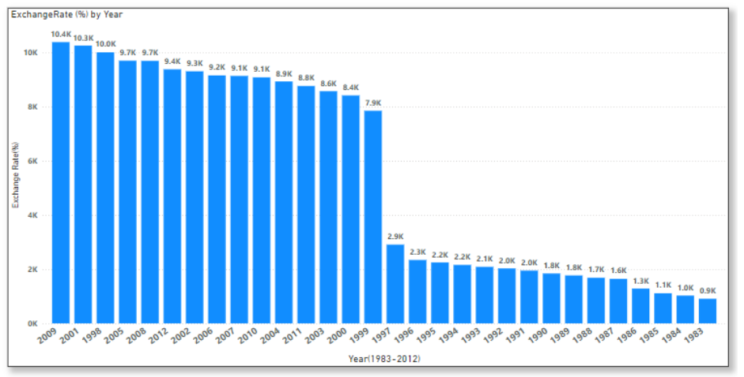

Slide 9
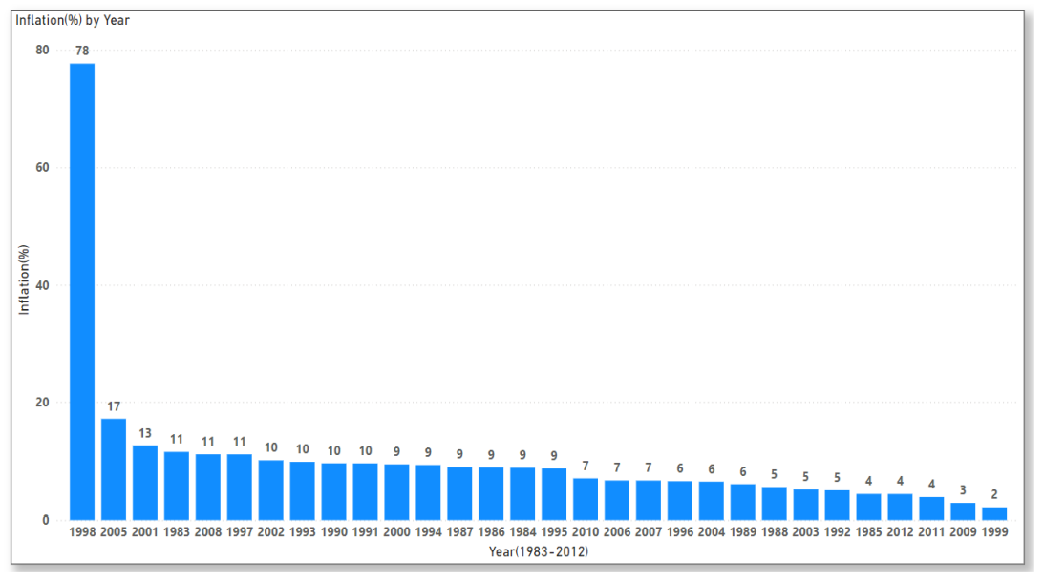
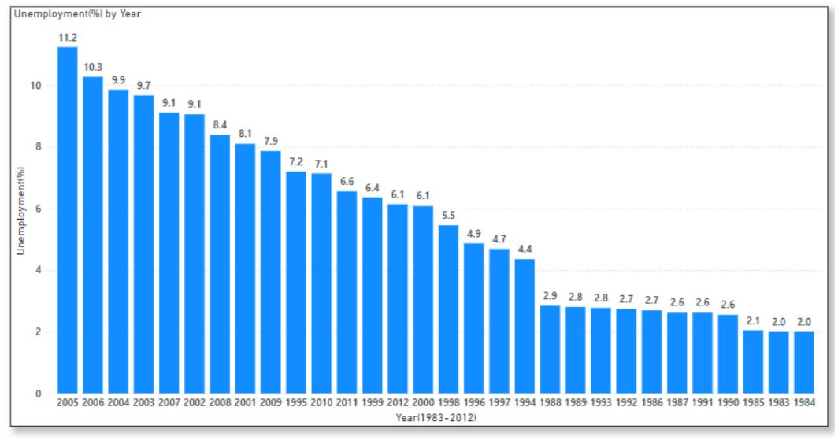

Slide 10
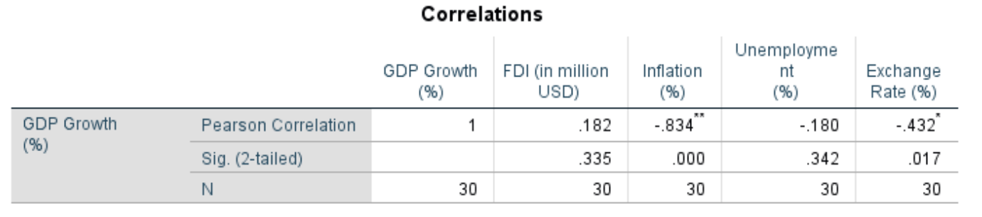
Correlation Analysis
GDP and FDI: Correlation of 0.182 indicates a weak positive relationship, but the p-value of 0.335 shows it is not statistically significant.
GDP and Inflation: Correlation of -0.834 indicates a strong negative relationship, with a significant p-value of 0.000, confirming an inverse relationship.
GDP and Unemployment: Correlation of -0.180 indicates a weak negative relationship, but the p-value of 0.342 shows it is not statistically significant.
GDP and Exchange Rates: Correlation of -0.432 indicates a moderate negative relationship, with a significant p-value of 0.017, confirming an inverse relationship.

Slide 11
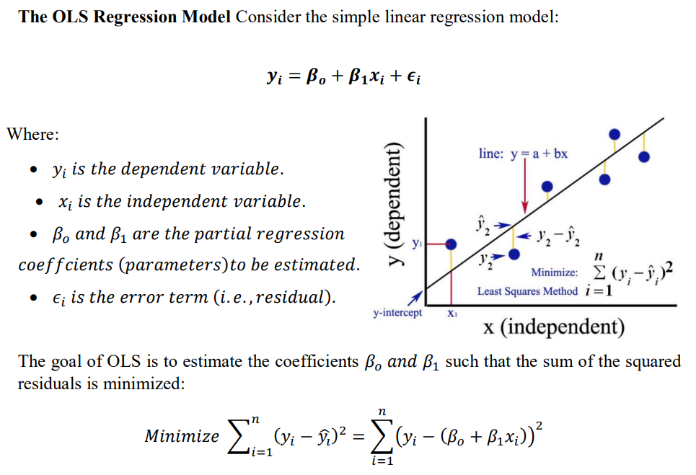
Ordinary Least Square Method and Its Assumption
The Ordinary Least Squares (OLS) method is a fundamental technique in statistical regression analysis, commonly used to estimate the parameters in a linear regression model. The primary objective of OLS is to find the best-fitting line through a set of data points by minimizing the sum of the squares of the vertical distances (residuals) between the observed values and the values predicted by the linear model.

Slide 12

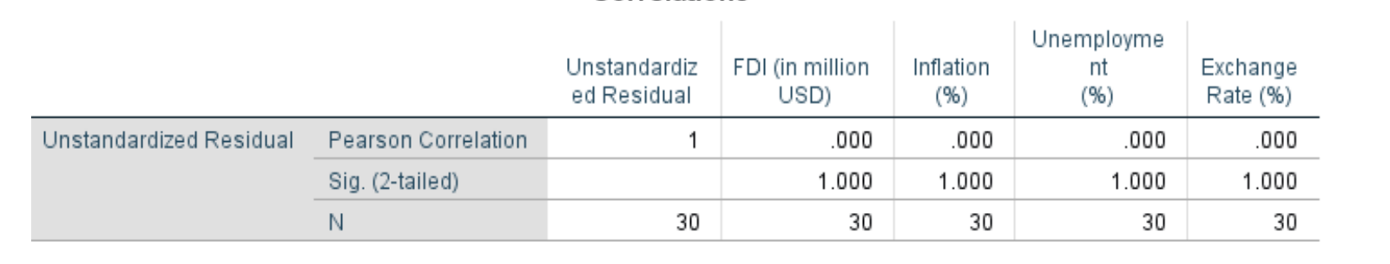
Assumption of Ordinary Least Square (OLS):
Linearity in Parameters: In multiple linear regression, it is generally assumed that the relationship between the dependent and independent variables is linear. However, this is just an assumption and may not always hold true in practice.
Random Sampling: The data should be collected through a process of random sampling, ensuring each observation is randomly selected and thus representative of the population.
Independence: Fixed X values or X values independent of the error term. Here, this means we require zero covariance between 𝑢𝑖 and each X variables.

Slide 13

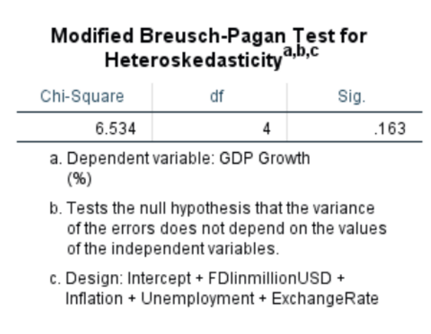
Homoscedasticity: The variance of the error terms should be constant across all levels of the independent variables.
The Modified Breusch-Pagan test checks for heteroscedasticity with the following hypotheses:
Null hypothesis: Homoscedasticity is present (the variance of errors does not depend on the independent variables: FDI, Inflation, Unemployment, Exchange Rate).
Alternative hypothesis: Heteroscedasticity is present (the variance of errors depends on the independent variables).
With a p-value of 0.163 (greater than 0.05), we do not have sufficient evidence to reject the null hypothesis. Therefore, there is no significant heteroscedasticity in the regression model.

Slide 14
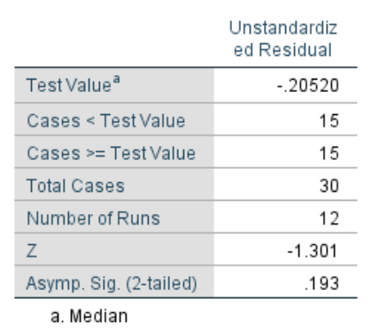
No Autocorrelation: The error terms should not be correlated with each other. This means the residuals from one observation should not be systematically related to the residuals from another observation.
The Runs Test is used to detect autocorrelation and randomness in data sequences.
Null Hypothesis: No autocorrelation in the residuals.
Alternative Hypothesis: Autocorrelation in the residuals.
The test on the unstandardized residuals shows no significant autocorrelation, with a Z-score of -1.301 and a p-value of 0.193 (greater than 0.05). Therefore, we fail to reject the null hypothesis, indicating no significant evidence of autocorrelation in the residuals at the 5% significance level.

Slide 15
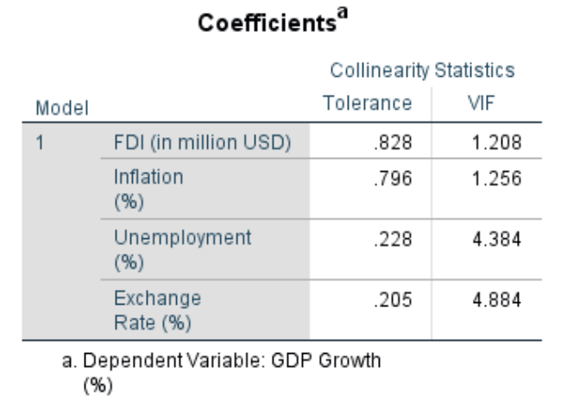
No Perfect Multicollinearity: There are no perfect linear relationships among the X variables. One way to detect multicollinearity is by using a metric known as the variance inflation factor (VIF), which measures the correlation and strength of correlation between the predictor variables in a regression model.
Since all VIF values are less than 5, we can confidently state that there is no significant multicollinearity among the predictor variables in our regression model.
In conclusion, since all VIF values are below 5, our regression model does not suffer from significant multicollinearity. This ensures that the estimates of our regression coefficients are reliable and not unduly influenced by correlations among the predictor variables.

Slide 16
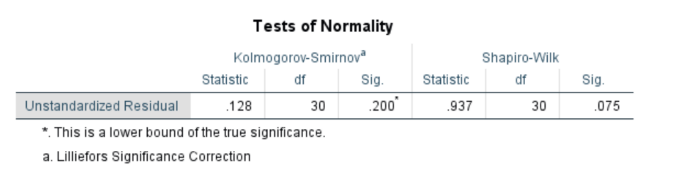
Normality of Error: In multiple linear regression econometrics, a fundamental assumption is that the error term (also referred to as the disturbance term or the residual term) is normally distributed.
The Kolmogorov-Smirnov (K-S) and Shapiro-Wilk (S-W) tests assess whether a sample comes from a specific distribution, typically the normal distribution.
Kolmogorov-Smirnov (K-S) Test:
Null Hypothesis: Sample data come from the specified distribution.
Alternative Hypothesis: Sample data do not come from the specified distribution.
Result: Sig. value of 0.200 (greater than 0.05), fail to reject the null hypothesis. Residuals are normally distributed.
Shapiro-Wilk (S-W) Test:
Null Hypothesis: Sample data come from a normally distributed population.
Alternative Hypothesis: Sample data do not come from a normally distributed population.
Result: Sig. value of 0.075 (greater than 0.05), fail to reject the null hypothesis. Residuals are normally distributed

Slide 17

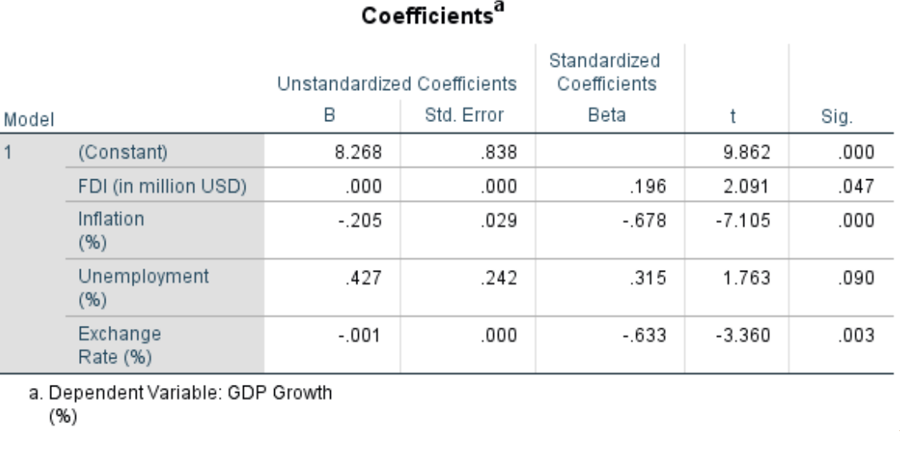
Multiple Regression: By incorporating these variables and regression coefficients, our model can be expressed as:
𝑌 = Gross Domestic Production (GDP), 𝑋1 = Foreign Direct Investment, 𝑋2 = Inflation, 𝑋3 = Unemployment, 𝑋4 = Exchange Rate, 𝛽𝜊 = Intercept Constant, 𝛽1, 𝛽2, 𝛽3 𝑎𝑛𝑑 𝛽4 𝑎𝑟𝑒 𝑅𝑒𝑔𝑟𝑒𝑠𝑠𝑖𝑜𝑛 𝐶𝑜𝑒𝑓𝑓𝑖𝑐𝑖𝑒𝑛𝑡𝑠.
The above table, yields the following multiple linear regression equation:

Slide 18
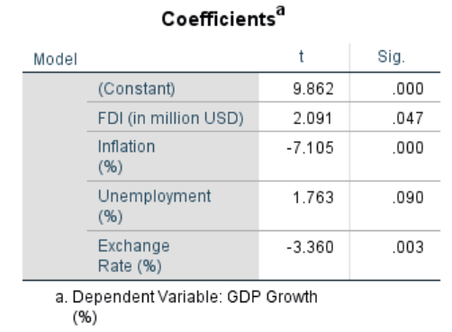
Test the Significance of the Coefficients or Partial Hypothesis Testing
Constant (Intercept) Hypothesis:
H₀: β₀ = 0 (Constant coefficient is zero)
H₁: β₀ ≠ 0 (Constant coefficient is not zero)
FDI Hypothesis:
H₀: β₁ = 0 (FDI has no effect on GDP growth)
H₁: β₁ ≠ 0 (FDI affects GDP growth)
Inflation Hypothesis:
H₀: β₂ = 0 (Inflation has no effect on GDP growth)
H₁: β₂ ≠ 0 (Inflation affects GDP growth)
Unemployment Hypothesis:
H₀: β₃ = 0 (Unemployment has no effect on GDP growth)
H₁: β₃ ≠ 0 (Unemployment affects GDP growth)
Exchange Rate Hypothesis:
H₀: β₄ = 0 (Exchange Rate has no effect on GDP growth)
H₁: β₄ ≠ 0 (Exchange Rate affects GDP growth
FDI: Sig < 0.05, reject H₀. FDI (X₁) significantly influences GDP growth.
Inflation: Sig < 0.05, reject H₀. Inflation (X₂) significantly impacts GDP growth.
Unemployment: Sig > 0.05, fail to reject H₀. Unemployment (X₃) does not significantly influence GDP growth.
Exchange Rate: Sig > 0.05, fail to reject H₀. Exchange Rate (X₄) does not significantly influence GDP growth.

Slide 19
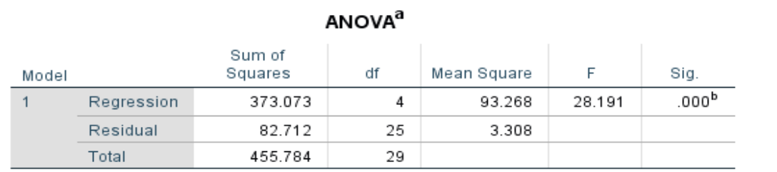
Overall Test of Significance (F-Test) or ANOVA
Hypotheses:
H₀: No significant linear relationship between predictors (Exchange Rate, Inflation, FDI, Unemployment) and GDP Growth.
H₁: Significant linear relationship between predictors and GDP Growth.
The F-Statistic value of 28.191 and a p-value of 0.000 indicate the overall model is statistically significant. We reject H₀ and conclude that the predictors (FDI, Inflation, Unemployment, Exchange Rate) collectively explain a significant portion of the variation in GDP Growth.

Slide 20
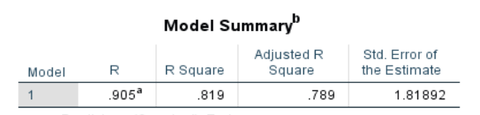
Model Summary
R: The correlation coefficient is 0.905, indicating a strong positive linear relationship between the predictors (Exchange Rate, Inflation, FDI, Unemployment) and GDP Growth.
R-Squared: The coefficient of determination is 0.819, meaning 81.9% of the variance in GDP Growth is explained by the model.
Adjusted R-Squared: Adjusted for the number of predictors, it is 0.789, slightly lower than R-Squared, accounting for potential overfitting.
Std. Error of the Estimate: The standard error is 1.81892, indicating the average deviation of predicted GDP Growth from actual values.
Overall, the model fits well, with predictors significantly explaining the variability in GDP Growth, as indicated by high R, R-Squared, and a significant F-test.

Slide 21


